Slide 1
Leveraging Content Providers

Slide 2
Overview
Explore different Android content providers
Learn about using the MediaStore, CallLog, Browser, CalendarContract, UserDictionary, VoicemailContract, Settings, and ContactsContract content providers
Access content providers that require permissions
Modify content provider data by adding, updating, and deleting records

Slide 3
Content Providers
An application can access data within other applications on the Android system through content provider interfaces and expose internal application data to other applications by becoming a content provider
Content providers are the way applications can access user information, including contact data, images, audio and video on the device, and much more

Slide 4
Warning!
Always run content provider code on test devices, not your personal devices
It is very easy to accidentally wipe out all of the Contacts database, your browser bookmarks, or other types of data on your devices
Consider this fair warning, because we discuss operations such as how to query (generally safe) and modify (not so safe) various types of device data

Slide 5
Exploring Android’s Content Providers
Android devices ship with a number of built-in applications, many of which expose their data as content providers
Your application can access content provider data from a variety of sources
You can find the content providers included with Android in the package android.provider

Slide 6
Exploring Android’s Content Providers (Cont’d)
Provider | Purpose
AlarmClock | Set alarms within the Alarm Clock application (API Level 9)
Browser | Browser history and bookmarks
CalendarContract | Calendar and event information (API Level 14)
CallLog | Sent and received calls
ContactsContract | Phone contact database or phonebook
MediaStore | Audio/visual data on the phone and external storage
SearchRecentSuggestions | Create appropriate search suggestions
Settings | System-wide device settings and preferences
UserDictionary | A dictionary of user-defined words for use with predictive text input
VoicemailContract | A single unified place for users to manage voicemail content from different sources (API Level 14)
Notes:
This table lists some useful content providers in the android.provider package.

Slide 7
Using the MediaStore Content Provider
You can use the MediaStore content provider to access media on the phone and on external storage devices
The primary types of media you can access are audio, images, and video
You can access these different types of media through their respective content provider classes under android.provider.MediaStore

Slide 8
Using the MediaStore Content Provider (Cont’d)
Most of the MediaStore classes allow full interaction with the data
You can retrieve, add, and delete media files from the device
There is also a handful of helper classes that define the most common data columns that can be requested

Slide 9
Using the MediaStore Content Provider (Cont’d)
Class | Purpose
Audio.Albums | Manages audio files organized by album
Audio.Artists | Manages audio files organized by artist
Audio.Genres | Manages audio files belonging to a particular genre
Audio.Media | Manages audio files on the device
Audio.Playlists | Manages audio files that are part of a particular playlist
Files | Listing of all media files (API Level 11)
Images.Media | Manages image files on the device
Images.Thumbnails | Retrieves thumbnails for the image files
Video.Media | Manages video files on the device
Video.Thumbnails | Retrieves thumbnails for the video files
Notes:
This table lists some commonly used classes you can find under android.provider.MediaStore.

Slide 10
Using the MediaStore Content Provider (Cont’d)
  String[] requestedColumns = {
  MediaStore.Audio.Media.TITLE,
  MediaStore.Audio.Media.DURATION
  };
  CursorLoader loader = new CursorLoader(this, MediaStore.Audio.Media.EXTERNAL_CONTENT_URI,
  requestedColumns, null, null, null);
  Cursor cur = loader.loadInBackground();
  Log.d(DEBUG_TAG, "Audio files: " + cur.getCount());
  Log.d(DEBUG_TAG, "Columns: " + cur.getColumnCount());
  int name = cur.getColumnIndex(MediaStore.Audio.Media.TITLE);
  int length = cur.getColumnIndex(MediaStore.Audio.Media.DURATION);
  cur.moveToFirst();
  while (!cur.isAfterLast()) {
  Log.d(DEBUG_TAG, "Title" + cur.getString(name));
  Log.d(DEBUG_TAG, "Length: " + cur.getInt(length) / 1000 + " seconds");
  cur.moveToNext();
  }
Notes:
The following code demonstrates how to request data from a content provider.
A query is made to the MediaStore to retrieve the titles of all the audio files on the SD card of the handset and their respective durations.
This code requires that you load some audio files onto the virtual SD card in the emulator.
The MediaStore.Audio.Media class has predefined strings for every data field (or column) exposed by the content provider. You can limit the audio file data fields requested as part of the query by defining a string array with the column names required. In this case, we limit the results to only the track title and the duration of each audio file.
We then use a CursorLoader and access the cursor using a loadInBackground() method call. The first parameter of the CursorLoader is the application context. The second parameter is the predefined URI of the content provider you want to query. The third parameter is the list of columns to return (audio file titles and durations). The fourth and fifth parameters control any selection-filtering arguments, and the sixth parameter provides a sort method for the results. We leave these null because we want all audio files at this location. By using the loadInBackground() method, we get a Cursor as a result. We then examine our Cursor for the results.

Slide 11
Using the CallLog Content Provider
Android provides a content provider to access the call log on the handset:
  android.provider.CallLog
You can use the CallLog to filter recently dialed calls, received calls, and missed calls
The date and duration of each call are logged and tied back to the Contacts application for caller identification purposes

Slide 12
Using the CallLog Content Provider (Cont’d)
The CallLog is a useful content provider for customer relationship management (CRM) applications
The user can also tag specific phone numbers with custom labels within the Contacts application

Slide 13
Using the CallLog Content Provider (Cont’d)
  String[] requestedColumns = {
  CallLog.Calls.CACHED_NUMBER_LABEL,
  CallLog.Calls.DURATION
  };
  CursorLoader loader = new CursorLoader(this, CallLog.Calls.CONTENT_URI, requestedColumns,
  CallLog.Calls.CACHED_NUMBER_LABEL + " = ?", new String[] { "HourlyClient123" }, null);
  Cursor calls = loader.loadInBackground();
  Log.d(DEBUG_TAG, "Call count: " + calls.getCount());
  int durIdx = calls.getColumnIndex(CallLog.Calls.DURATION);
  int totalDuration = 0;
  calls.moveToFirst();
  while (!calls.isAfterLast()) {
  Log.d(DEBUG_TAG, "Duration: " + calls.getInt(durIdx));
  totalDuration += calls.getInt(durIdx);
  calls.moveToNext();
  }
  Log.d(DEBUG_TAG, "HourlyClient123 Total Call Duration: " + totalDuration);
Notes:
To demonstrate how the CallLog content provider works, let’s look at a hypothetical situation where we want to generate a report of all calls to a number with the custom label HourlyClient123. Android allows for custom labels on these numbers, which we leverage for this code example.
This code is similar to the code shown for the MediaStore audio files. Again, we start with listing our requested columns: the call label and the duration of the call. This time, however, we don’t want to get every call in the log, only those with a label of HourlyClient123. To filter the results of the query to this specific label, it is necessary to specify the fourth and fifth parameters of the CursorLoader. Together, these two parameters are equivalent to a database WHERE clause. The fourth parameter specifies the format of the WHERE clause with the column name, with selection parameters (shown as ?) for each selection argument value. The fifth parameter, the string array, provides the values to substitute for each of the selection arguments (?) in order as you would do for a simple SQLite database query.
We use the same method to iterate the records of the Cursor and add up all the call durations

Slide 14
Accessing Content Providers That Require Permissions
Your application needs a special permission to access the information provided by the CallLog content provider
You can declare the <uses-permission> tag using the Android IDE Wizard, or you can add the following to your AndroidManifest.xml file:
  <uses-permission android:name="android.permission.READ_CONTACTS">
  </uses-permission>
Notes:
Although it’s a tad confusing, there is no CallLog provider permission.
Instead, applications that access the CallLog use the READ_CONTACTS permission.
Although the values are cached within this content provider, the data is similar to what you might find in the contacts provider.

Slide 15
Using the Browser Content Provider
The built-in Browser content provider exposes the user’s browser site history and bookmarked websites
You access this content provider via the android.provider.Browser class
As with the CallLog class, you can use the information provided by the Browser content provider to generate statistics and to provide cross-application functionality
You might use the Browser content provider to add a bookmark for your application support website

Slide 16
Using the Browser Content Provider (Cont’d)
  String[] requestedColumns = {
  Browser.BookmarkColumns.TITLE,
  Browser.BookmarkColumns.VISITS,
  Browser.BookmarkColumns.BOOKMARK
  };
  CursorLoader loader = new CursorLoader(this, Browser.BOOKMARKS_URI, requestedColumns,
  Browser.BookmarkColumns.BOOKMARK + "=1", null,
  Browser.BookmarkColumns.VISITS + " DESC limit 5");
  Cursor faves = loader.loadInBackground();
  Log.d(DEBUG_TAG, "Bookmarks count: " + faves.getCount());
  int titleIdx = faves.getColumnIndex(Browser.BookmarkColumns.TITLE);
  int visitsIdx = faves.getColumnIndex(Browser.BookmarkColumns.VISITS);
  int bmIdx = faves.getColumnIndex(Browser.BookmarkColumns.BOOKMARK);
  faves.moveToFirst();
  while (!faves.isAfterLast()) {
  Log.d("SimpleBookmarks", faves.getString(titleIdx) + " visited "
  + faves.getInt(visitsIdx) + " times : " + (faves.getInt(bmIdx) != 0 ? "true" : "false"));
  faves.moveToNext();
  }
Notes:
In this example, we query the Browser content provider to find the top five most frequently visited bookmarked sites.
Again, the requested columns are defined, the query is made, and the cursor iterates through the results.
Note that the CursorLoader has become substantially more complex. Let’s take a look at the parameters to this method in more detail. The second parameter, Browser.BOOKMARKS_URI, is a URI for all browser history, not only the bookmarked items. The third parameter defines the requested columns for the query results. The fourth parameter specifies that the bookmark property must be true. This parameter is needed in order to filter within the query. Now the results are only browser history entries that have been bookmarked. The fifth parameter, selection arguments, is used only when replacement values are used. It is not used in this case, so the value is set to null. Last, the sixth parameter specifies an order for the results (most visited in descending order).

Slide 17
Using the Browser Content Provider (Cont’d)
Retrieving browser history information requires setting the READ_HISTORY_BOOKMARKS permission

Slide 18
Using the CalendarContract Content Provider
Introduced officially in Android 4.0 (API Level 14), the CalendarContract provider allows you to manage and interact with the user’s calendar data on the device
You can use this content provider to create one-time and recurring events in a user’s calendar, set reminders, and more, provided the device user has appropriately configured calendar accounts (for example, Microsoft Exchange)

Slide 19
Using the CalendarContract Content Provider (Cont’d)
  Intent calIntent = new Intent(Intent.ACTION_INSERT);
  calIntent.setData(CalendarContract.Events.CONTENT_URI);
  calIntent.putExtra(CalendarContract.Events.TITLE, "My Winter Holiday Party");
  calIntent.putExtra(CalendarContract.Events.EVENT_LOCATION, "My Ski Cabin at Tahoe");
  calIntent.putExtra(CalendarContract.Events.DESCRIPTION, "Hot chocolate, eggnog and sledding.");
  startActivity(calIntent);
Notes:
In addition to the fully featured content provider, you can also quickly trigger a new event to be added to the user’s calendar using an Intent, as seen here.
Here we seed the calendar event title, location, and description using the appropriate Intent Extras. These fields will be set in a form that displays for the user, who will then need to confirm the event in the calendar app.

Slide 20
Using the UserDictionary Content Provider
Another useful content provider is the UserDictionary provider
You can use this content provider for predictive text input on text fields and other user input mechanisms
Individual words stored in the dictionary are weighted by frequency and organized by locale
You can use the addWord() method within the UserDictionary.Words class to add words to the custom user dictionary

Slide 21
Using the VoicemailContract Content Provider
The VoicemailContract content provider was introduced in API Level 14
You can use this content provider to add new voicemail content to the shared provider so that all voicemail content is accessible in one place
Application permissions, such as the ADD_VOICEMAIL permission, are necessary for accessing this provider

Slide 22
Using the Settings Content Provider
You can use the Settings content provider to access the device settings and user preferences
Settings are organized much as they are in the Settings application—by category
You can find information about the Settings content provider in the android.provider.Settings class
If your application needs to modify system settings, you’ll need to register the WRITE_SETTINGS or WRITE_SECURE_SETTINGS permissions in your application’s Android manifest file

Slide 23
Introducing the ContactsContract Content Provider
The Contacts database is one of the most commonly used applications on the mobile phone
  People always want phone numbers handy for calling friends, family, coworkers, and clients
  Most phones show the identity of the caller based on the contacts application, including nicknames, photos, or icons
Android provides a built-in Contacts application, and the contact data is exposed to other Android applications using the content provider interface
This means you can leverage the user’s contact data within your application for a more robust user experience

Slide 24
Introducing the ContactsContract Content Provider (Cont’d)
The content provider for accessing user contacts was originally called Contacts
Android 2.0 (API Level 5) introduced an enhanced contacts management content provider class to manage the data available from the user’s contacts
This provider, called ContactsContract, includes a subclass called ContactsContract.Contacts
This is the preferred contacts content provider

Slide 25
Introducing the ContactsContract Content Provider (Cont’d)
Your application needs special permission to access the private user information provided by the ContactsContract content provider
You must declare a <uses-permission> tag using the permission READ_CONTACTS to read this information
If your application modifies the Contacts database, you’ll need the WRITE_CONTACTS permission as well

Slide 26
Introducing the ContactsContract Content Provider (Cont’d)
The ContactsContract content provider was further enhanced in Android 4.0 (Ice Cream Sandwich, API Level 14) to incorporate substantive social networking features, including
  Managing the device user’s identity
  Favorite methods of communication with specific contacts
  INVITE_CONTACT Intent type for applications to use to make contact connections
The device user’s personal profile is accessible through the ContactsContract.Profile class
  This requires the READ_PROFILE application permission
The device user’s preferred methods of communicating with specific contacts can be accessed through the ContactsContract.DataUsageFeedback class
For more information, see the Android SDK documentation for the android.provider.ContactsContract class

Slide 27
Working with ContactsContract Content Provider
    String[] requestedColumns = {
    ContactsContract.Contacts.DISPLAY_NAME,
    ContactsContract.CommonDataKinds.Phone.NUMBER,
    };
    CursorLoader loader = new CursorLoader(this, ContactsContract.Data.CONTENT_URI,
    requestedColumns, null, null, "display_name desc limit 1");
    Cursor contacts = loader.loadInBackground();
    int recordCount = contacts.getCount();
    Log.d(DEBUG_TAG, "Contacts count: " + recordCount);
    if (recordCount > 0) {
    int nameIdx = contacts
    .getColumnIndex(ContactsContract.Contacts.DISPLAY_NAME);
    int phoneIdx = contacts
    .getColumnIndex(ContactsContract.CommonDataKinds.Phone.NUMBER);
    contacts.moveToFirst();
    Log.d(DEBUG_TAG, "Name: " + contacts.getString(nameIdx));
    Log.d(DEBUG_TAG, "Phone: " + contacts.getString(phoneIdx));
    }
Notes:
This code utilizes the ContactsContract provider.
The code uses a query URI provided from the ContactsContract provider called ContactsContract.Data.CONTENT_URI. You’re requesting different column names. The column names of the ContactsContract provider are organized more thoroughly to allow for far more dynamic contact configurations. This can make your queries slightly more complex. Luckily, the ContactsContract.CommonDataKinds class has a number of frequently used columns defined together.

Slide 28
Working with ContactsContract Content Provider (Cont’d)
Class | Purpose
ContactsContract.CommonDataKinds | Defines a number of frequently used Contact columns, e.g., email, nickname, phone, photo
ContactsContract.Contacts | Defines consolidated data associated with a contact; some aggregation may be performed
ContactsContract.Data | Defines the raw data associated with a single contact
ContactsContract.PhoneLookup | Defines phone columns and can be used to quickly look up a number for caller ID purposes
ContactsContract.StatusUpdates | Defines social networking columns and can be used to check a contact’s IM status
Notes:
This table shows some of the commonly used classes that can help you work with the ContactsContract content provider.

Slide 29
Modifying Content Provider Data
Content providers are not only static sources of data; they can also be used to add, update, and delete data, if the content provider application has implemented this functionality
Your application must have the appropriate permissions
  WRITE_CONTACTS as opposed to READ_CONTACTS to perform some of these actions

Slide 30
Adding Records
  ArrayList<ContentProviderOperation> ops = new ArrayList<ContentProviderOperation>();
  int contactIdx = ops.size();
  ContentProviderOperation.Builder op =
  ContentProviderOperation.newInsert(ContactsContract.RawContacts.CONTENT_URI);
  op.withValue(ContactsContract.RawContacts.ACCOUNT_NAME, null);
  op.withValue(ContactsContract.RawContacts.ACCOUNT_TYPE, null);
  ops.add(op.build());
  ...
Notes:
Using the ContactsContract content provider, we can, for example, add a new record to the Contacts database programmatically. This code adds a new contact named Ian Droid with a phone number of 6505551212.
Here we use the ContentProviderOperation class to create an ArrayList of operations to insert records into the Contacts database on the device. The first record we add with newInsert() is ACCOUNT_NAME and ACCOUNT_TYPE.

Slide 31
Adding Records (Cont’d)
...
op = ContentProviderOperation.newInsert(ContactsContract.Data.CONTENT_URI);
op.withValue(ContactsContract.Data.MIMETYPE,
ContactsContract.CommonDataKinds.StructuredName.CONTENT_ITEM_TYPE);
op.withValue(ContactsContract.CommonDataKinds.StructuredName.DISPLAY_NAME,
"Ian Droid");
op.withValueBackReference(ContactsContract.Data.RAW_CONTACT_ID,
contactIdx);
ops.add(op.build());
...
Notes:
The second record we add with newInsert() is a name for the ContactsContract.CommonDataKinds.StructuredName.DISPLAY_NAME column. We need to create the contact with a name before we can assign information, such as phone numbers. Think of this as creating a row in a table that provides a one-to-many relationship to a phone number table.

Slide 32
Adding Records (Cont’d)
  ...
  op = ContentProviderOperation.newInsert(ContactsContract.Data.CONTENT_URI);
  op.withValue(ContactsContract.CommonDataKinds.Phone.NUMBER,
  "6505551212");
  op.withValue(ContactsContract.CommonDataKinds.Phone.TYPE,
  ContactsContract.CommonDataKinds.Phone.TYPE_WORK);
  op.withValue(ContactsContract.CommonDataKinds.Phone.MIMETYPE,
  ContactsContract.CommonDataKinds.Phone.CONTENT_ITEM_TYPE);
  op.withValueBackReference(ContactsContract.Data.RAW_CONTACT_ID,
  contactIdx);
  ops.add(op.build());
  getContentResolver().applyBatch(ContactsContract.AUTHORITY, ops);
Notes:
The third record we add with newInsert() is a phone number for the contact that we are adding to the contacts database.
We insert the data in the database found at the ContactsContract.Data.CONTENT_URI path.

Slide 33
Updating Records
  String selection = ContactsContract.Data.DISPLAY_NAME + " = ? AND " +
  ContactsContract.Data.MIMETYPE + " = ? AND " +
  String.valueOf(ContactsContract.CommonDataKinds.Phone.TYPE) + " = ? ";
  String[] selectionArgs = new String[] {
  "Ian Droid",
  ContactsContract.CommonDataKinds.Phone.CONTENT_ITEM_TYPE,
  String.valueOf(ContactsContract.CommonDataKinds.Phone.TYPE_WORK)};
  ArrayList<ContentProviderOperation> ops =
  new ArrayList<ContentProviderOperation>();
  ContentProviderOperation.Builder op =
  ContentProviderOperation.newUpdate(ContactsContract.Data.CONTENT_URI);
  op.withSelection(selection, selectionArgs);
  op.withValue(ContactsContract.CommonDataKinds.Phone.NUMBER,
  "6501234567");
  ops.add(op.build());
  getContentResolver().applyBatch(ContactsContract.AUTHORITY, ops);
Notes:
Inserting data isn’t the only change you can make. You can update one or more rows as well. The following block of code shows how to update data within a content provider. In this case, we update a phone number field for a specific contact.
Again, we use the ContentProviderOperation class to create an ArrayList of operations to update a record in the Contacts database on the device—in this case, the phone number field previously given a TYPE_WORK attribute. This replaces any current phone number stored in the NUMBER field with a TYPE_WORK attribute currently stored with the contact. We add the ContentProviderOperation with the newUpdate() method and once again use applyBatch() on the ContentResolver class to complete our change. We can then confirm that only one row was updated.

Slide 34
Deleting All Records
ArrayList<ContentProviderOperation> ops =
new ArrayList<ContentProviderOperation>();
ContentProviderOperation.Builder op =
ContentProviderOperation.newDelete(ContactsContract.RawContacts.CONTENT_URI);
ops.add(op.build());
getContentResolver().applyBatch(ContactsContract.AUTHORITY, ops);
Notes:
The following code deletes all rows at the given URI. Keep in mind that you should execute operations like this with extreme care.
The newDelete() method deletes all rows at a given URI, which, in this case, includes all rows at the RawContacts.CONTENT_URI location (in other words, all contact entries).

Slide 35
Deleting Specific Records
  String selection = ContactsContract.Data.DISPLAY_NAME + " = ? ";
  String[] selectionArgs = new String[] { "Ian Droid" };
  ArrayList<ContentProviderOperation> ops =
  new ArrayList<ContentProviderOperation>();
  ContentProviderOperation.Builder op =
  ContentProviderOperation.newDelete(ContactsContract.RawContacts.CONTENT_URI);
  op.withSelection(selection, selectionArgs);
  ops.add(op.build());
  getContentResolver().applyBatch(ContactsContract.AUTHORITY, ops);
Notes:
Often you want to select specific rows to delete by adding selection filters to remove rows matching a particular pattern.
The following newDelete() operation matches all contact records with the name Ian Droid, which we used when we created the contact previously.

Slide 36
Using Third-Party Content Providers
Any application can implement a content provider to share its information safely and securely with other applications on the device
Some applications use content providers only to share information internally—within their own brand, for example
Others publish the specifications for their providers so that any other applications that want to integrate with them can

Slide 37
Using Third-Party Content Providers (Cont’d)
If you poke around in the Android source code, or run across a content provider you want to use, consider this: a number of other content providers are available on the Android platform, especially those used by some of the typically installed Google applications (Calendar, Messaging, and so on)
Be aware, though, that using undocumented content providers, simply because you happen to know how they work or have reverse-engineered them, is generally not a good idea
Use of undocumented and non-public content providers can make your application unstable
This post on the Android Developers Blog makes a good case for why this sort of hacking should be discouraged in commercial applications: http://android-developers.blogspot.com/2010/05/be-careful-with-content-providers.html

Slide 38
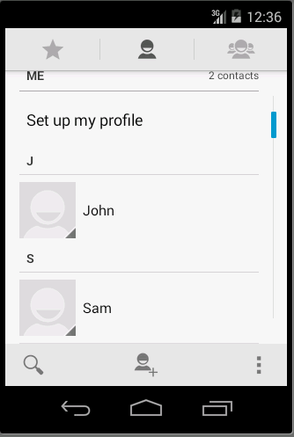
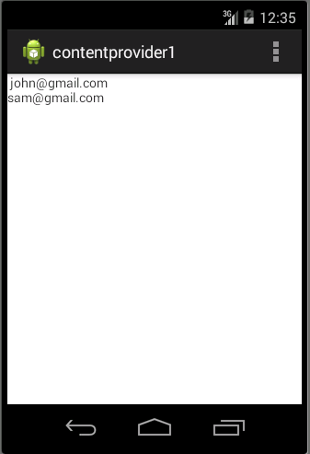
Example
Getting All Email from contacts

Slide 39
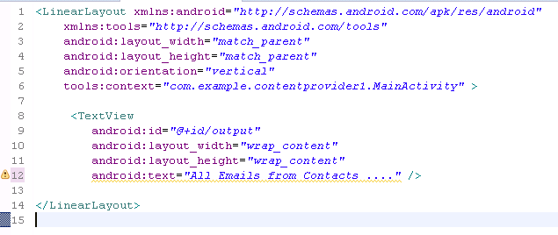

Activity_main.xml

Slide 40
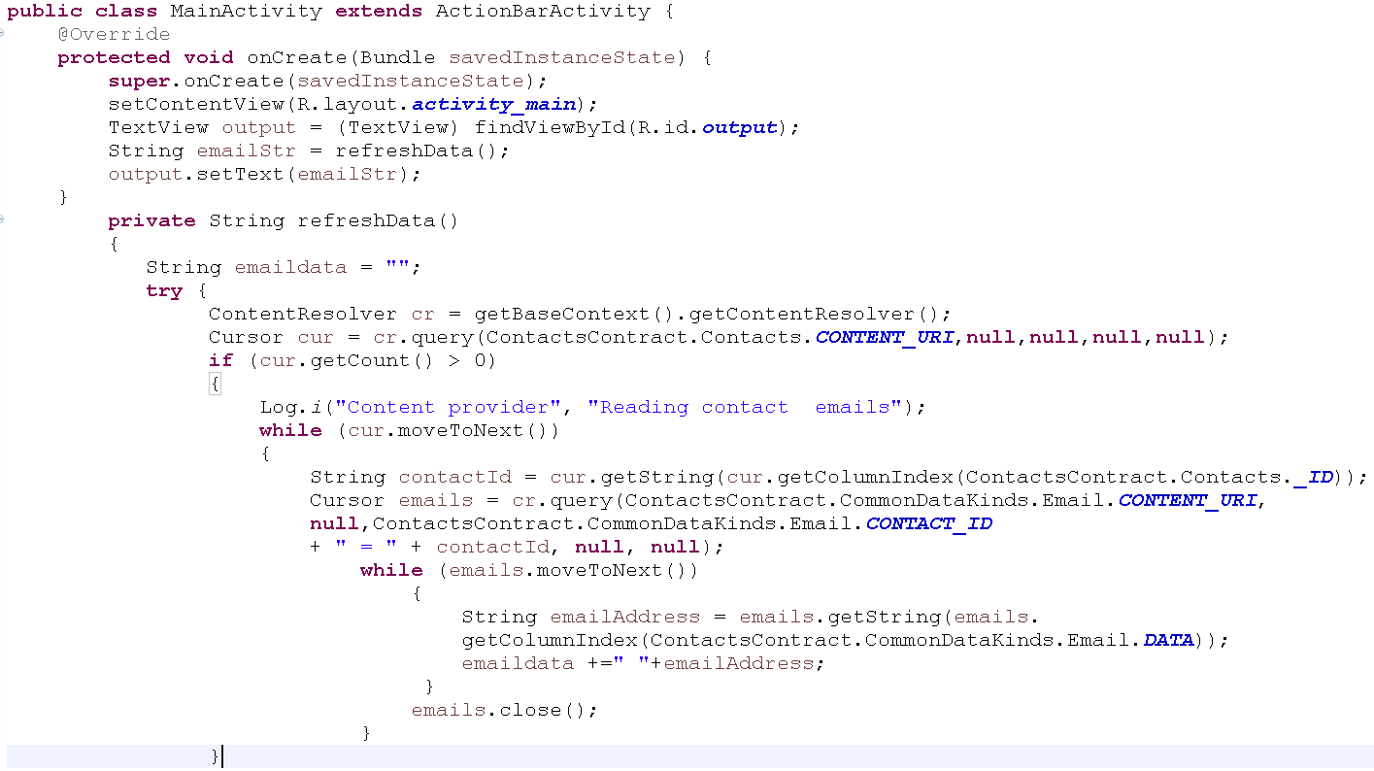
MainActivity.java

Slide 41
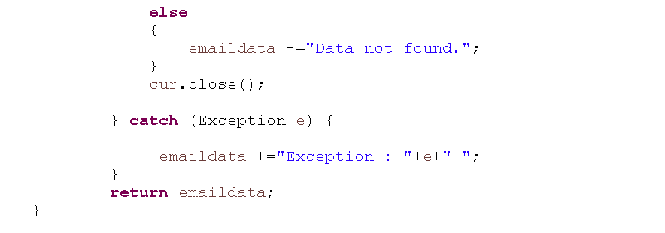
MainActivity.java

